Slide 1

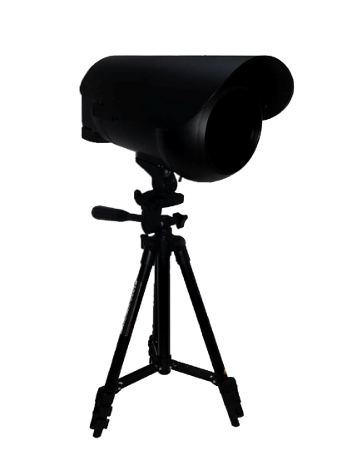
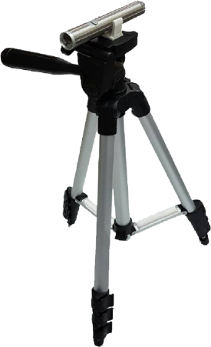
Sciencetific Invention
“SPEED ANALYSER”
Kanchanapisek Wittayalai Nakhonpathom School
(Pratumnak Suankularb Mattayom)

Slide 2
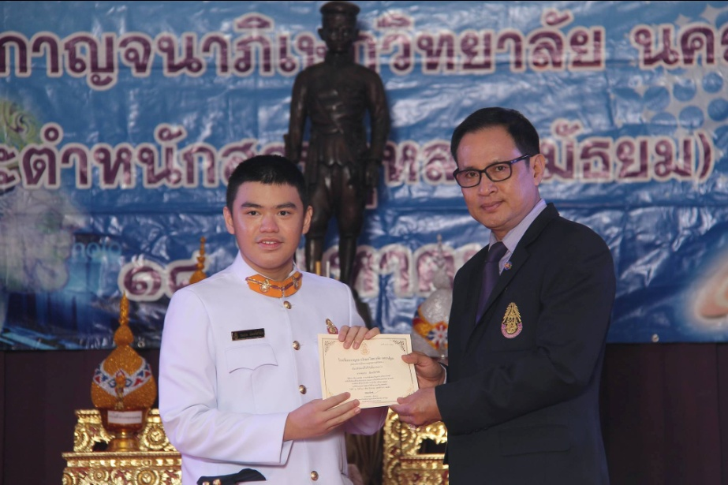
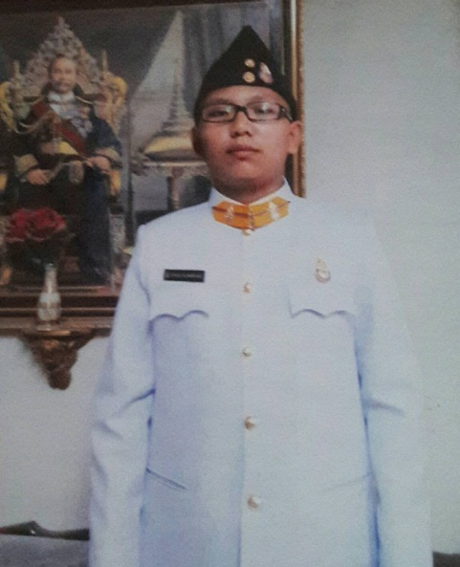
Created by
Chomtana Chanjaraswichai
Kittiphum Prasitchaipun

Slide 3
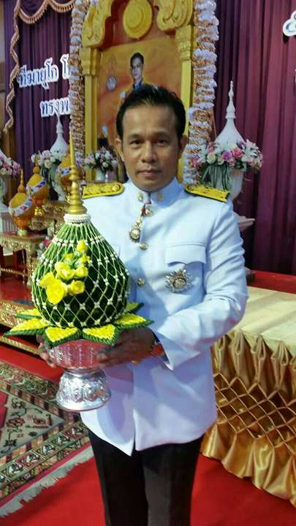
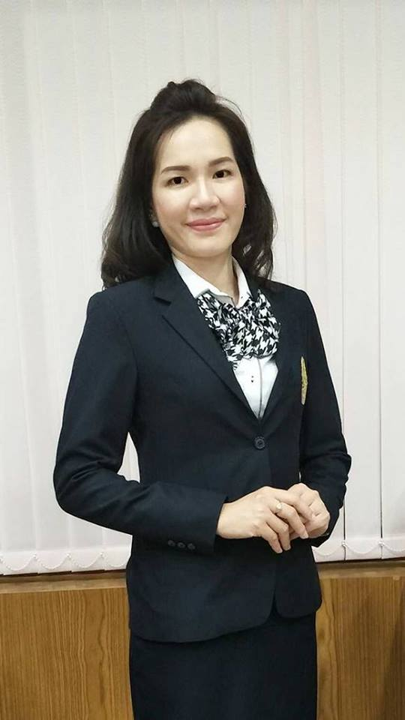
Advisors
Mr.Chanchai Chanlit
Mrs.Orawan Srathongyoo

Slide 4
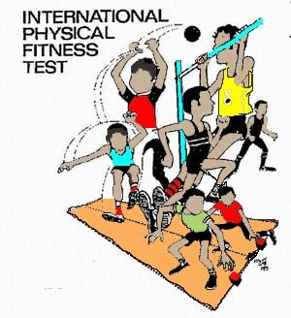
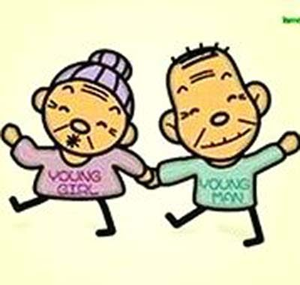
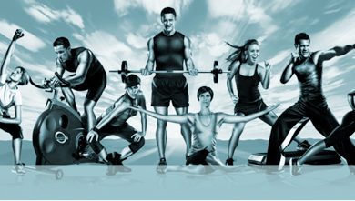
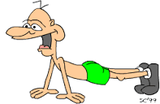
Physical fitness
Physical fitness means physical condition that can carry out activities Effectively And include all the features of health and well-being.

Slide 5
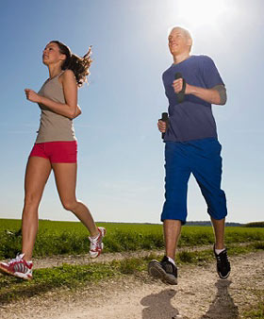
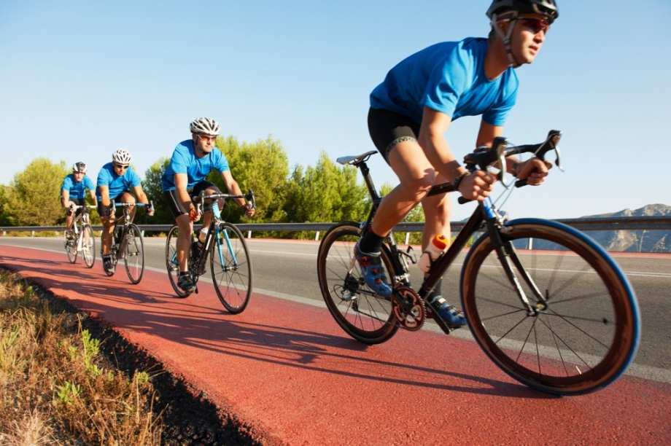
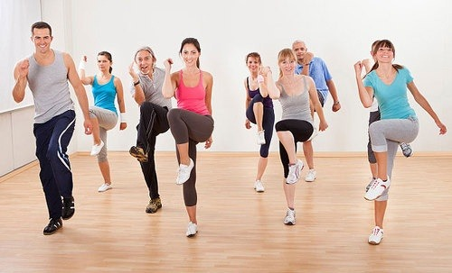
Physical fitness related to health
Good condition of the body makes it possible to carry out daily tasks actively. Reduce the risk of health problems due to lack of exercise.

Slide 6
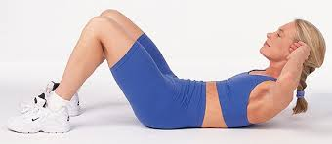
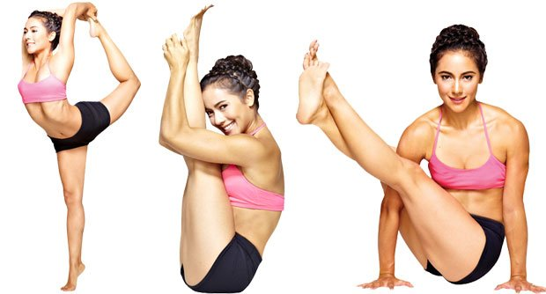
Physical fitness related to health
1. Muscular Strength
2. Muscular Endurance
3. Cardiorespiratory Endurance
4. Flexibility
5. Body Composition

Slide 7
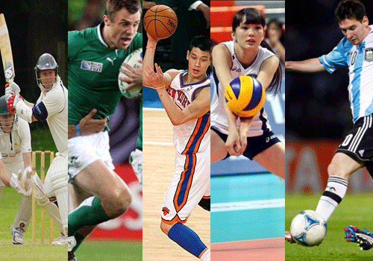
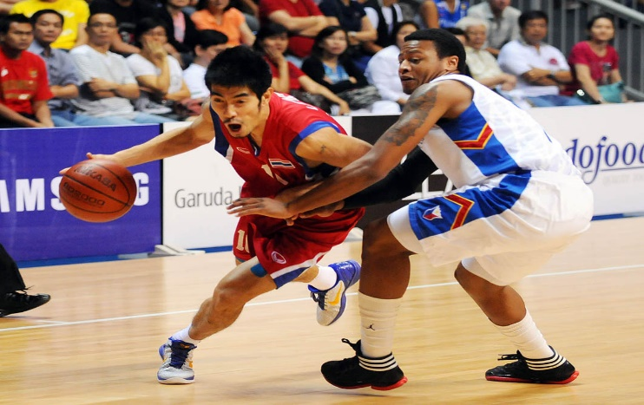
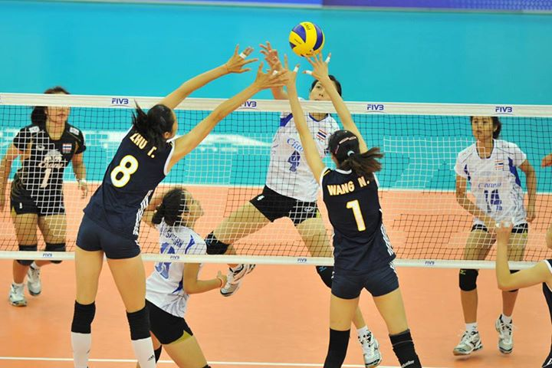
Physical fitness related to skills
The physical fitness required for sport.
This will make sport the most effective.

Slide 8
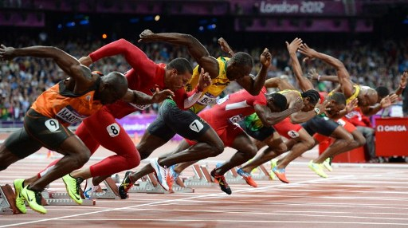
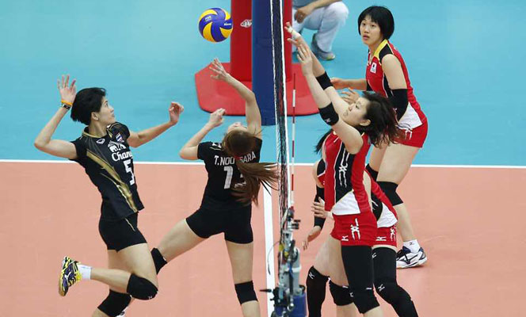
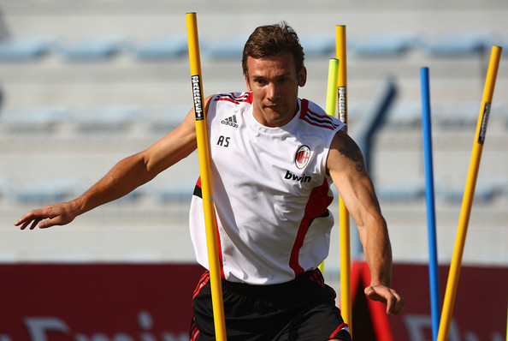
Physical fitness related to skills.
1.Speed
2. Muscle Power
3. Agility

Slide 9
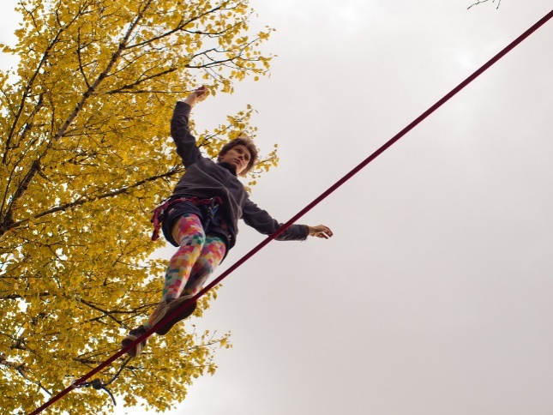
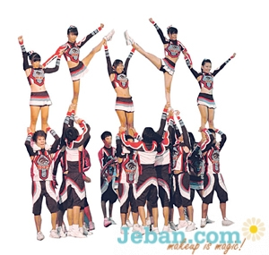
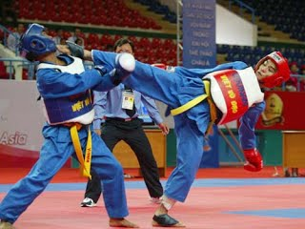
Physical fitness related to skills.
4.Balance
6. Coordination
5. Reaction Time

Slide 10
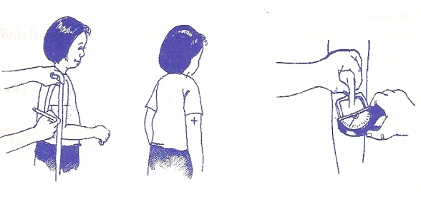
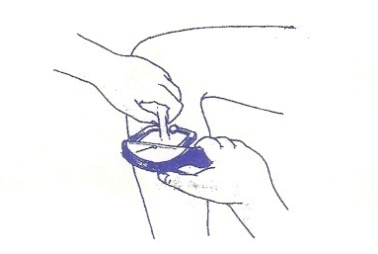
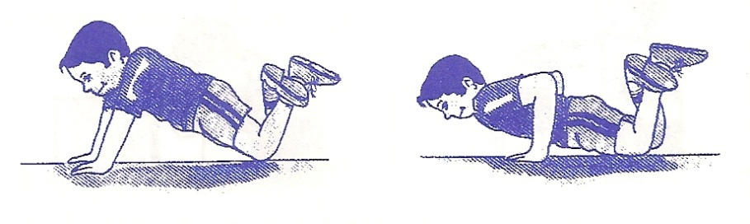
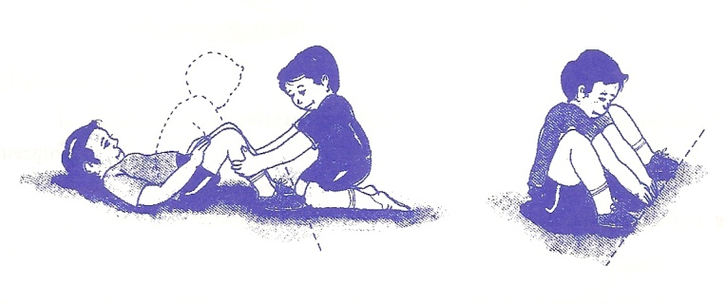
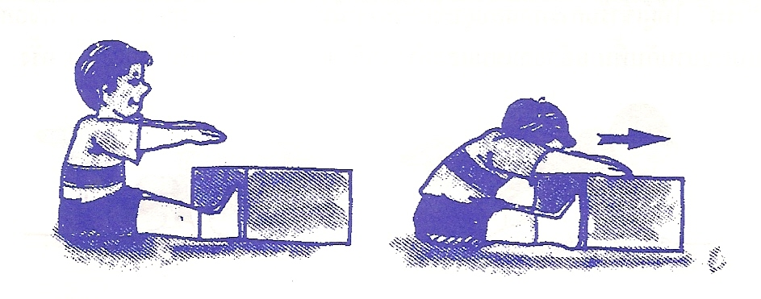
Physical Fitness Tests
BMI
Skin fold
Push up
Sit-up
Sit and reach

Slide 11
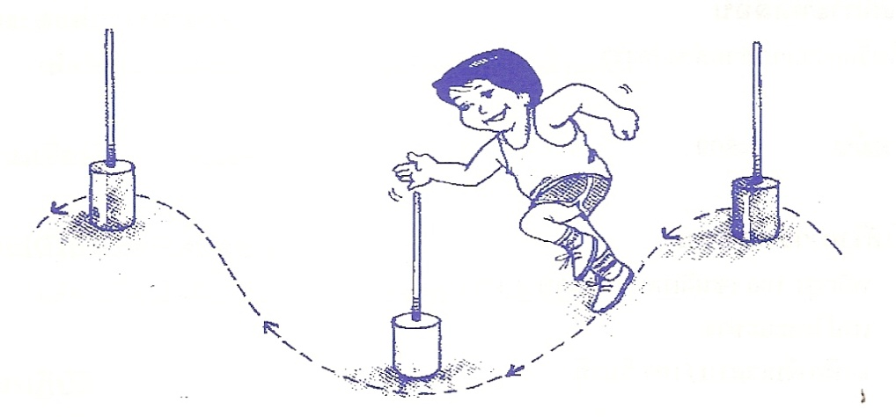
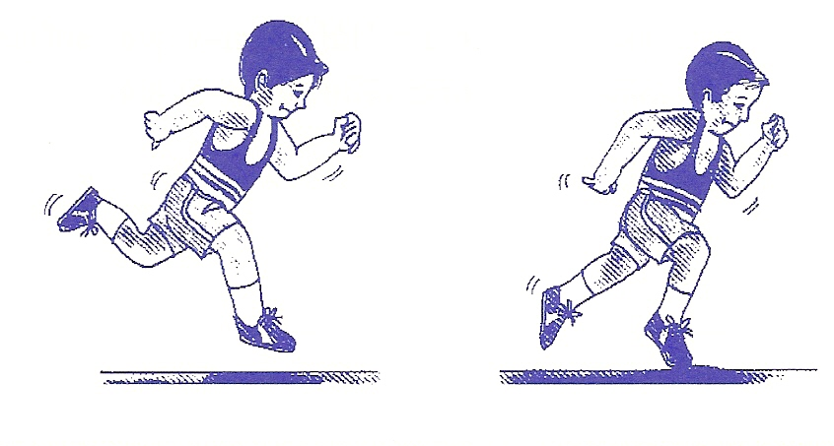
Physical Fitness Tests
Zig-zag run
Run

Slide 12
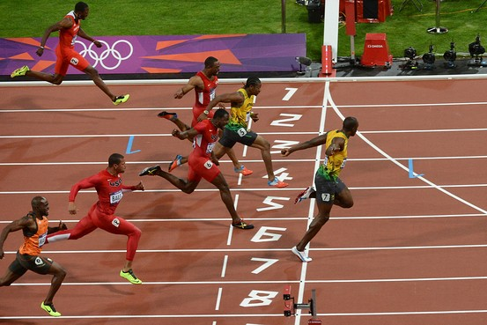
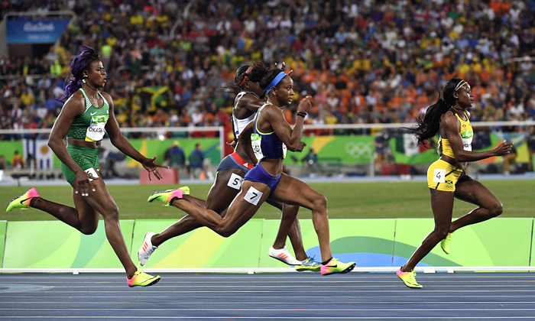
Speed
Speed is the ability to move to the desired goal in the shortest possible time. The muscles must expert and shrink with maximum speed

Slide 13
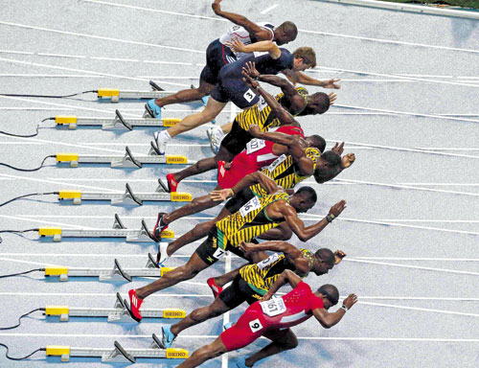
Steps of short run speed.
In the first 15 meters the corners of body are still low and very forward and that is speed of the acceleration. Until the distance of 30 meters

Slide 14
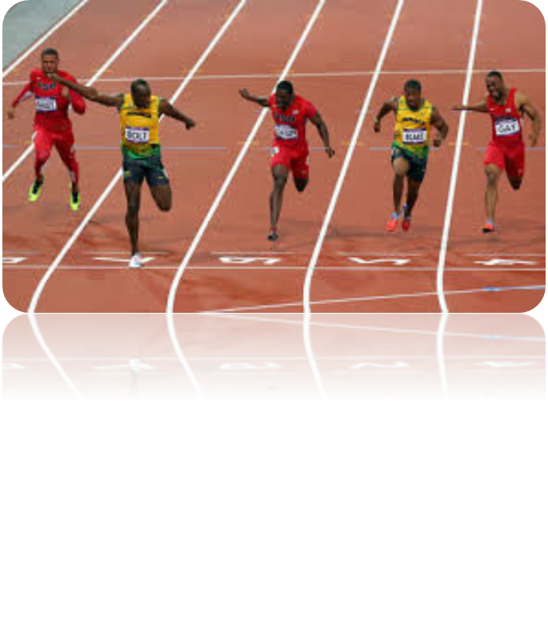
Steps of short run speed.
The range of 30 – 50 meters speed will gradually increase to the peak.

Slide 15
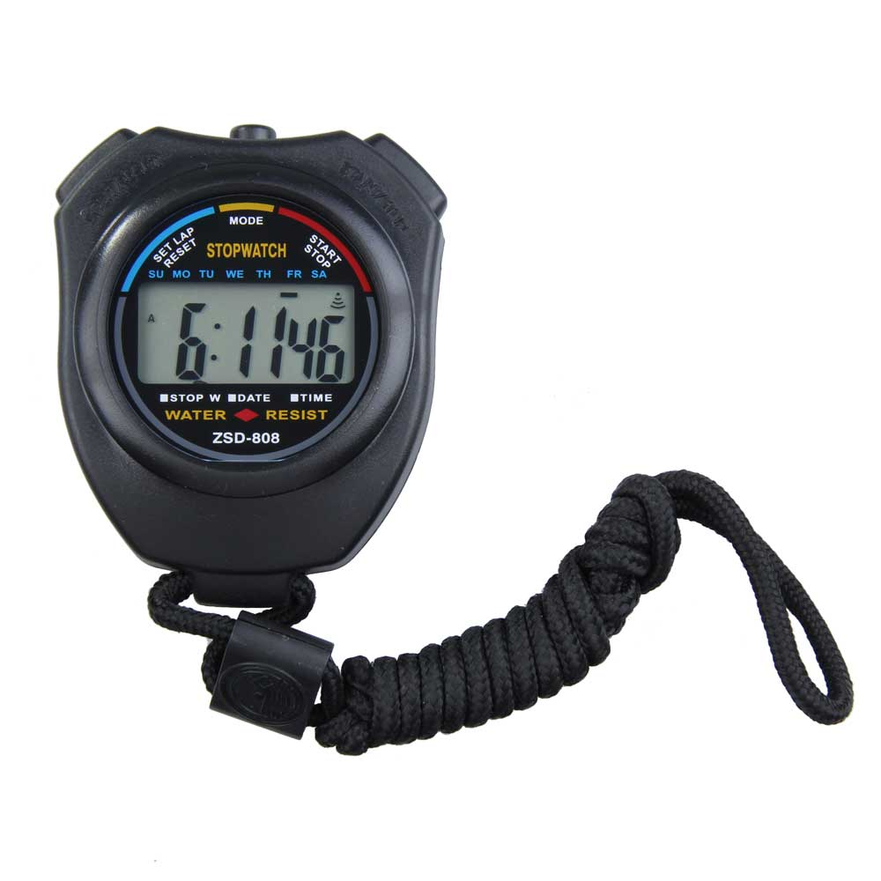
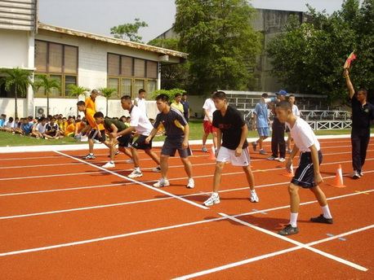
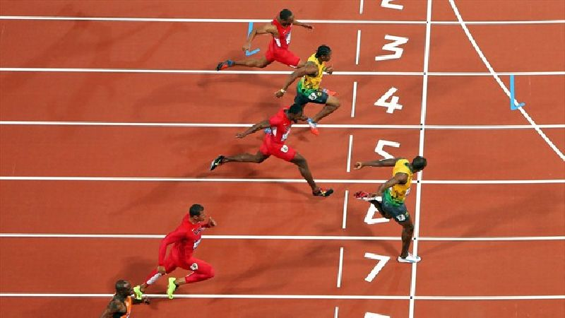
Speed test equipment

Slide 16
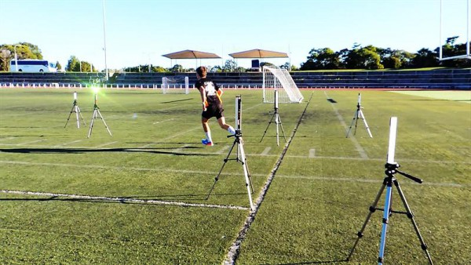
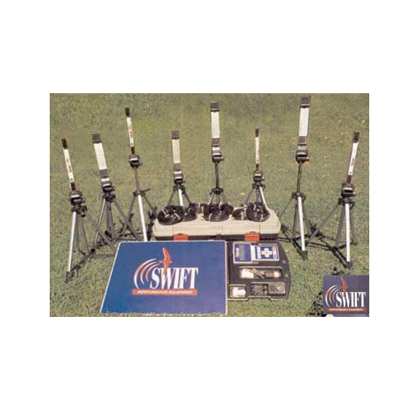
Swift SpeedLight timing training systems
Swift SpeedLight timing training systems are similar to SPEED analyzers developed by the research team. The price is. £ 446.40 – £ 15,192.00 (approximately 22,320 - 759,600 baht), which is a very high price.

Slide 17
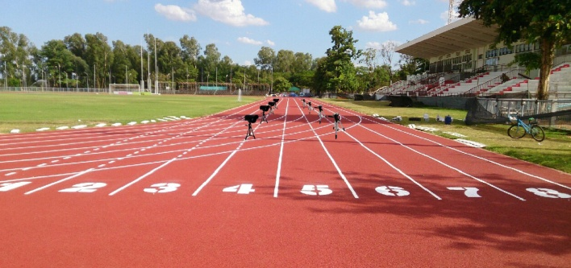
Layout of equipment of “SPEED ANALYSER”

Slide 18
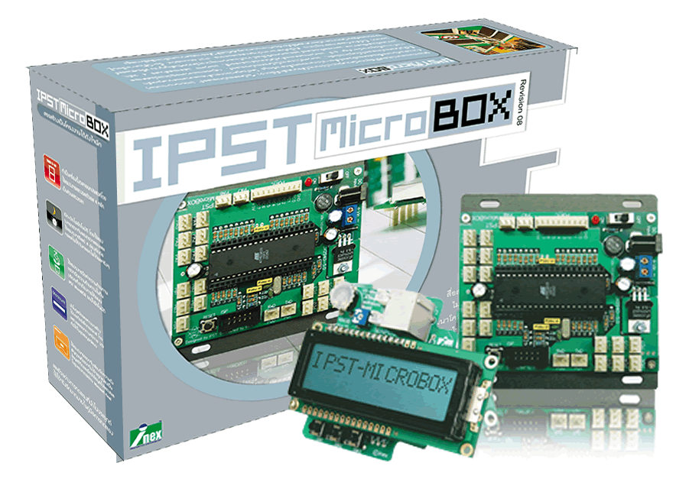
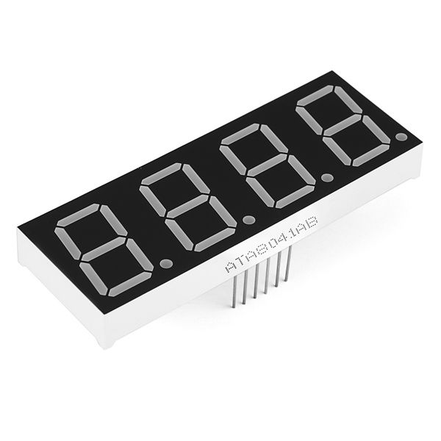
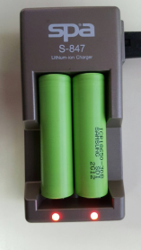
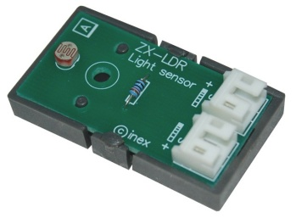
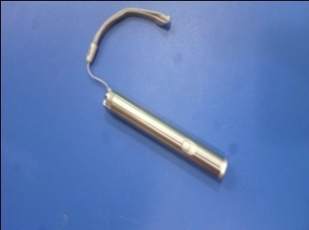
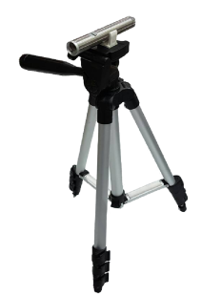

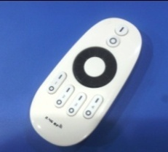
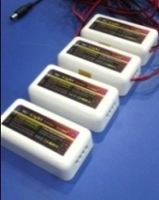
Material used in speed analyser
IPST - Microbox
ZX-LDR
7-Segment display
Laser pointers
3V rechargeable
battery
Tripods
Camera housing box
Remote signal receiver
Remote

Slide 19
Research Objectives
To design and create Speed Analyser.
To study performance of Speed Analyser.

Slide 20
Scope of research
The samples are male students in grade 10 - 12. Number of 10 people between 16-18 years of academic year 2016
Kanchanapisek Wittayalai Nakhonpathom School
(Pratumnak Suankularb Mattayom)
(Specific random sampling)

Slide 21
Hypothesis
Speed Analyser can work effectively to know the running speed of 50 meters in 4 distance of 0 - 15, 0 - 30, 0 – 40 and 0 - 50 meters, respectively.
The test results can be used to develop a physical fitness program that is related to 50-meter runner speed.

Slide 22
Variable studied
Independent Variable
Speed Analyser
Dependent Variable
1. Efficiency of speed analyser
2. Results recorded from speed analyser
Control Variable
1. Distance to run
2. The age of samples

Slide 23
Design and build process
Study related document.
Study information about process of speed analyser.
Study information about materials that used to build speed analyser.

Slide 24
Design and build process
4. Study information about how to position speed analyser in testing.
start
finish
Remarks
is a laser
is a speed analyser

Slide 25
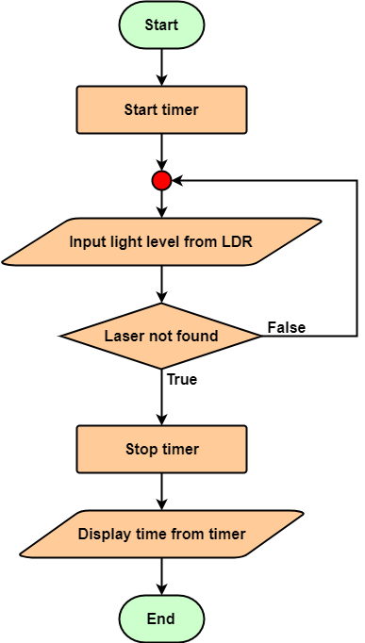
Design and build process
5. Create flowchart that show process of program in IPST-Microbox.

Slide 26

Design and build process
6. Program IPST-Microbox by following this step.
6.1 Write program according to flowchart that created in step 5.

Slide 27

Design and build process
6.2 Compile written program.
6.3 Connect IPST - Microbox to computer and program IPST - Microbox.

Slide 28

Design and build process
7. Install speed analyser components.

Slide 29
Design and build process
8. Test speed analyser in simulating room.
9. Test speed analyser in real place.

Slide 30
Evaluation and testing process
Order 4 timekeepers to stand in 15, 30, 40, 50 meters distance and order speed analyser starter to stand in 50 meters distance.
Order a participant to move to starting point.
Signal the participant to start running. When the timekeepers and the speed analyser starter hear the signal, the speed analyser starter will start speed analyser and the timekeepers will start their stopwatches.

Slide 31
Evaluation and testing process
4. When the participant move through each defined distances that are 15, 30, 40 and 50 meter, timekeeper in each distance must stop her stopwatches.
5. Record times that the speed analysers show and times of each timekeeper.
6. Repeat step 2 to 5 for each participant until all participants are tested. When all participant are tested, test all participants again.

Slide 32
Evaluation and testing process
7. Calculate error between times recorded from each timekeeper and speed analysers.
8. Use recorded times to calculate running speed of each participant and then use calculated running speed to create fitness training program for each participant.

Slide 33
Digital timers evaluation result
Time from digital timer using 3 timer at 0-15 meters
Timekeeper | Time in the range of 0 - 15 meters (sec)
 | First | Second | Third
1. | 3.02 | 3.06 | 2.87
2. | 2.91 | 2.39 | 3.05
3. | 3.19 | 2.84 | 2.94
Average | 3.04 | 2.76 | 2.95

Slide 34
Digital timers evaluation result
Time from digital timer using 3 timer at 0 – 15 meters

Slide 35
Digital timers evaluation result
Time from digital timer using 3 timer at 0 - 30 meters
Timekeeper | Time in the range of 0 - 30 meters (sec)
 | First |  | ครั้งที่ 3
1. | 4.89 | 4.99 | 5.20
2. | 4.93 | 4.93 | 6.20
3. | 5.11 | 5.23 | 5.23
ค่าเฉลี่ย | 4.98 | 5.05 | 5.54

Slide 36
Digital timers evaluation result
Time from digital timer using 3 timer at 0 – 30 meters

Slide 37
Digital timers evaluation result
Time from digital timer using 3 timer at 0 - 40 meters
Timekeeper | Time in the range from 0 - 40 meters (sec)
 | First | Second | Third
1. | 6.88 | 6.16 | 6.37
2. | 6.01 | 6.24 | 6.47
3. | 6.11 | 6.28 | 6.32
Average | 6.33 | 6.23 | 6.39

Slide 38
Digital timers evaluation result
Time from digital timer using 3 timer at 0 – 40 meters

Slide 39
Digital timers evaluation result
Time from digital timer using 3 timer at 0 – 50 meters
Timekeeper | Time in the range from 0 - 50 meters (sec)
 | First | Second | Third
1. | 7.70 | 8.40 | 8.12
2. | 7.61 | 8.50 | 8.10
3. | 7.76 | 8.50 | 8.27
Average | 7.69 | 8.47 | 8.16

Slide 40
Digital timers evaluation result
Time from digital timer using 3 timer at 0 - 50 meters

Slide 41
Test result (0 – 15 meters)
Time and speed of running range form 0 to 15 meters.
The test taker | Digital tmer |  | Speed Analyser
 | Time (s) | Speed (m/s) | Time (s) | Speed (m/s)
1. | 2.77 | 5.42 | 2.53 | 5.93
2. | 2.90 | 5.17 | 2.86 | 5.24
3. | 2.43 | 6.17 | 2.31 | 6.49
4. | 2.33 | 6.44 | 2.29 | 6.55
5. | 2.38 | 6.30 | 2.64 | 5.68
6. | 2.53 | 5.93 | 2.76 | 5.43
7. | 2.79 | 5.38 | 2.81 | 5.34
8. | 2.55 | 5.88 | 2.67 | 5.62
9. | 2.58 | 5.81 | 2.75 | 5.45
10. | 2.51 | 5.98 | 2.34 | 6.41
Average | 2.58 | 5.85 | 2.60 | 5.82

Slide 42
Test result (0 – 30 meters)
Time and speed of running range form 0 to 30 meters.
The test taker | Digital timer |  | Speed Analyser
 | Time (s) | Speed (m/s) | Time (s) | Speed (m/s)
1. | 4.08 | 7.35 | 4.33 | 6.93
2. | 4.94 | 6.07 | 4.86 | 6.17
3. | 4.30 | 6.98 | 4.31 | 6.96
4. | 4.36 | 6.88 | 4.19 | 7.16
5. | 4.59 | 6.54 | 4.57 | 6.56
6. | 4.84 | 6.20 | 4.64 | 6.47
7. | 4.90 | 6.12 | 4.85 | 6.19
8. | 4.77 | 6.29 | 4.49 | 6.68
9. | 4.61 | 6.51 | 4.50 | 6.67
10. | 4.41 | 6.80 | 4.37 | 6.86
Average | 4.58 | 6.57 | 4.51 | 6.67

Slide 43
Test result (0 – 40 meters)
Time and speed of running range form 0 to 40 meters.
The test taker | Digital timer |  | Speed Analyser
 | Time (s) | Speed (m/s) | Time (s) | Speed (m/s)
1. | 5.37 | 7.45 | 5.49 | 7.29
2. | 5.94 | 6.73 | 6.17 | 6.48
3. | 5.53 | 7.23 | 5.47 | 7.31
4. | 5.43 | 7.37 | 5.29 | 7.56
5. | 6.24 | 6.41 | 5.91 | 6.77
6. | 6.31 | 6.34 | 6.01 | 6.66
7. | 6.23 | 6.42 | 6.15 | 6.50
8. | 5.99 | 6.68 | 5.71 | 7.01
9. | 5.94 | 6.73 | 5.71 | 7.01
10. | 5.33 | 7.50 | 5.53 | 7.23
Average | 5.83 | 6.89 | 5.74 | 6.98

Slide 44
Test result (0 – 50 meters)
Time and speed of running range form 0 to 50 meters.
The test taker | Digital timer |  | Speed Analyser
 | Time (s) | Speed (m/s) | Time (s) | Speed (m/s)
1. | 6.71 | 7.45 | 7.08 | 7.06
2. | 7.09 | 7.05 | 7.38 | 6.78
3. | 6.55 | 7.63 | 6.63 | 7.54
4. | 6.94 | 7.20 | 6.62 | 7.55
5. | 7.41 | 6.75 | 7.27 | 6.88
6. | 7.31 | 6.84 | 7.24 | 6.91
7. | 7.37 | 6.78 | 7.48 | 6.68
8. | 6.88 | 7.27 | 6.93 | 7.22
9. | 7.12 | 7.02 | 6.95 | 7.19
10. | 7.45 | 6.71 | 6.69 | 7.47
Average | 7.08 | 7.07 | 7.03 | 7.13

Slide 45
Test result (Overall)
Time and speed to run all distance
The test taker | Speed in each distance
 | 0 – 15 | 0 – 30 | 0 – 40 | 0 – 50
1. | 5.93 | 6.93 | 7.29 | 7.06
2. | 5.24 | 6.17 | 6.48 | 6.78
3. | 6.49 | 6.96 | 7.31 | 7.54
4. | 6.55 | 7.16 | 7.56 | 7.55
5. | 5.68 | 6.56 | 6.77 | 6.88
6. | 5.43 | 6.47 | 6.66 | 6.91
7. | 5.34 | 6.19 | 6.50 | 6.68
8. | 5.62 | 6.68 | 7.01 | 7.22
9. | 5.45 | 6.67 | 7.01 | 7.19
10. | 6.41 | 6.86 | 7.23 | 7.47
Average | 5.82 | 6.67 | 6.98 | 7.13

Slide 46
Test result (Overall)
The graph shows the speed of run of 10 participants

Slide 47
Test result (first person)
Speed chart of each distance of first person

Slide 48
Test result (second person)
Speed chart of each distance of second person

Slide 49
Test result (third person)
Speed chart of each distance of third person

Slide 50
Test result (fourth person)
Speed chart of each distance of fourth person

Slide 51
Test result (fifth person)
Speed chart of each distance of fifth person

Slide 52
Test result (sixth person)
Speed chart of each distance of sixth person

Slide 53
Test result (seventh person)
Speed chart of each distance of seventh person

Slide 54
Test result (eighth person)
Speed chart of each distance of eighth person

Slide 55
Test result (nineth person)
Speed chart of each distance of nineth person

Slide 56
Test result (tenth person)
Speed chart of each distance of tenth person

Slide 57
Conclusion
Can design and create Speed Analyser have succeeded
Speed Analyser has high accuracy
The test takers had a distinct performance relative to their speed skills, with the average speed of 5.82 m / s in the range of 15 to 30 m in the 0 to 15 m range, with an average speed of 6.67 m / s. The range of 30-40 meters has an average speed of 6.98 m / s in the range of 40 to 50 m with an average speed of 7.13 m / s.

Slide 58
Conclusion

Slide 59
Conclusion
4.The average running speed can be used to develop physical fitness programs that relate to speeding skills. The distance of 50 meters is as follows.

Slide 60
Applying results
Training and training programs Plyometric Training (Plyometric Training) It is a pattern and muscle training program that connects muscle strength with muscle contraction speed, resulting in muscle strength, plyometric training. Use jumping activities. Jumping Jumping with the lower body and spinning Throwing and shoving the ball with the ball using the upper body.

Slide 61


Applying results

Slide 62

Applying results
ANAEROBIC TRANING PROGRAM
Use a training style wit a full sprint of 70 – 90% of the maximum heart rate (according to individual student’s ability to run at full speed)

Slide 63
Thanks for your attention
If there are some mistake please apologize
Kanchanapisek Wittayalai Nakhonpathom School
(Pratumnak Suankularb Mattayom)

